Slide 1
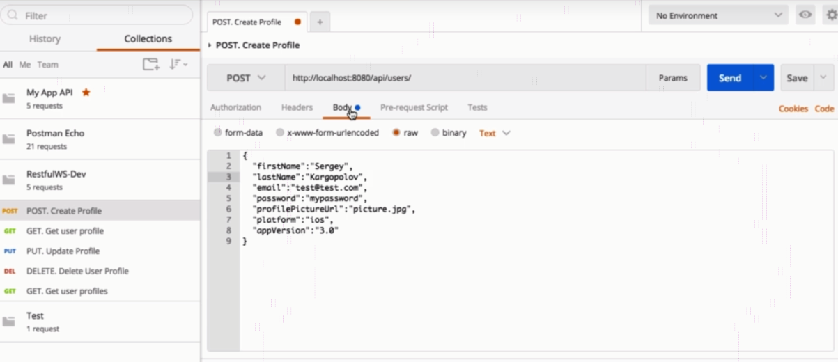
HTTP Headers

Slide 2
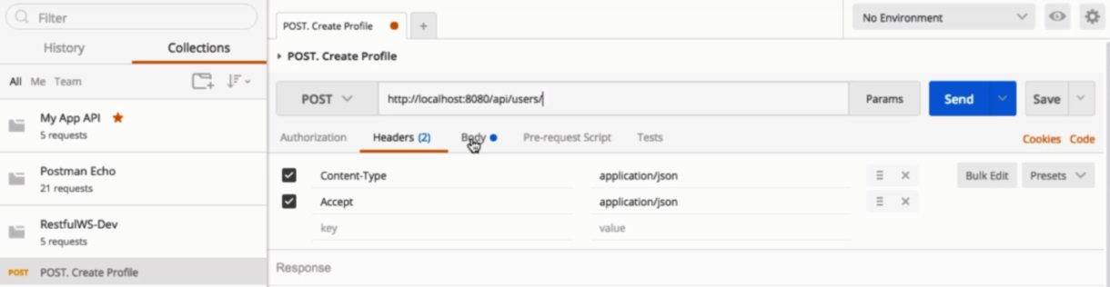
HTTP Headers

Slide 3
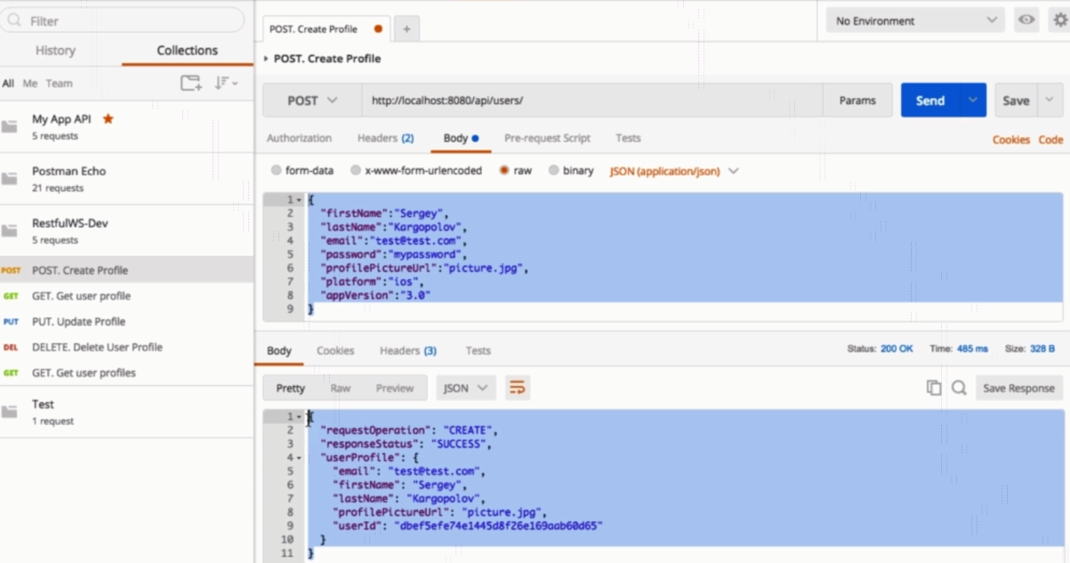
HTTP Headers

Slide 4
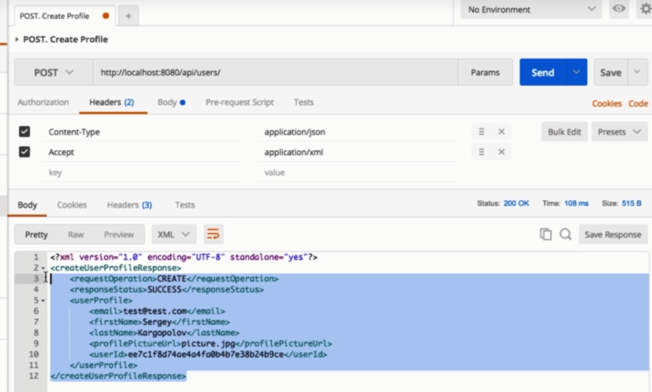
HTTP Headers

Slide 5
Postman Overview
https://www.udemy.com/course/restful-web-services-with-spring-framework-a-quick-start/learn/lecture/11769764#overview

